Slide 1
H(ome). A(utomation). L(ogic). – Final Presentation
Matthew Lamoureux-Durr

Slide 2
Agenda/Topics To Be Covered
Original Goal/Requirements
Design
Hardware
Code
Implementation/Compromise
Timeline
Costs

Slide 3
Original Goal
I want to be able to control my house from my bed.
Setup routines that will automatically execute themselves.
Good user interface.
Easy to use from everywhere
Internet enabled!
Standalone

Slide 4
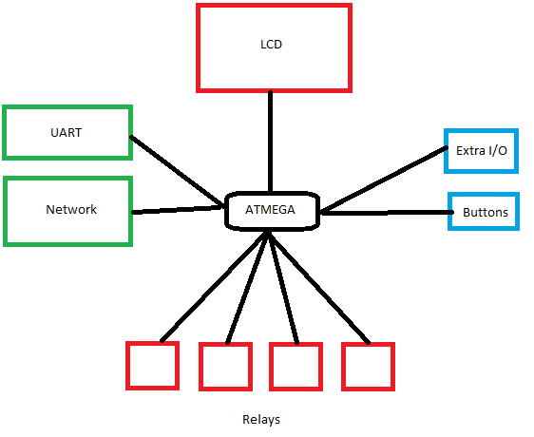
Design

Slide 5
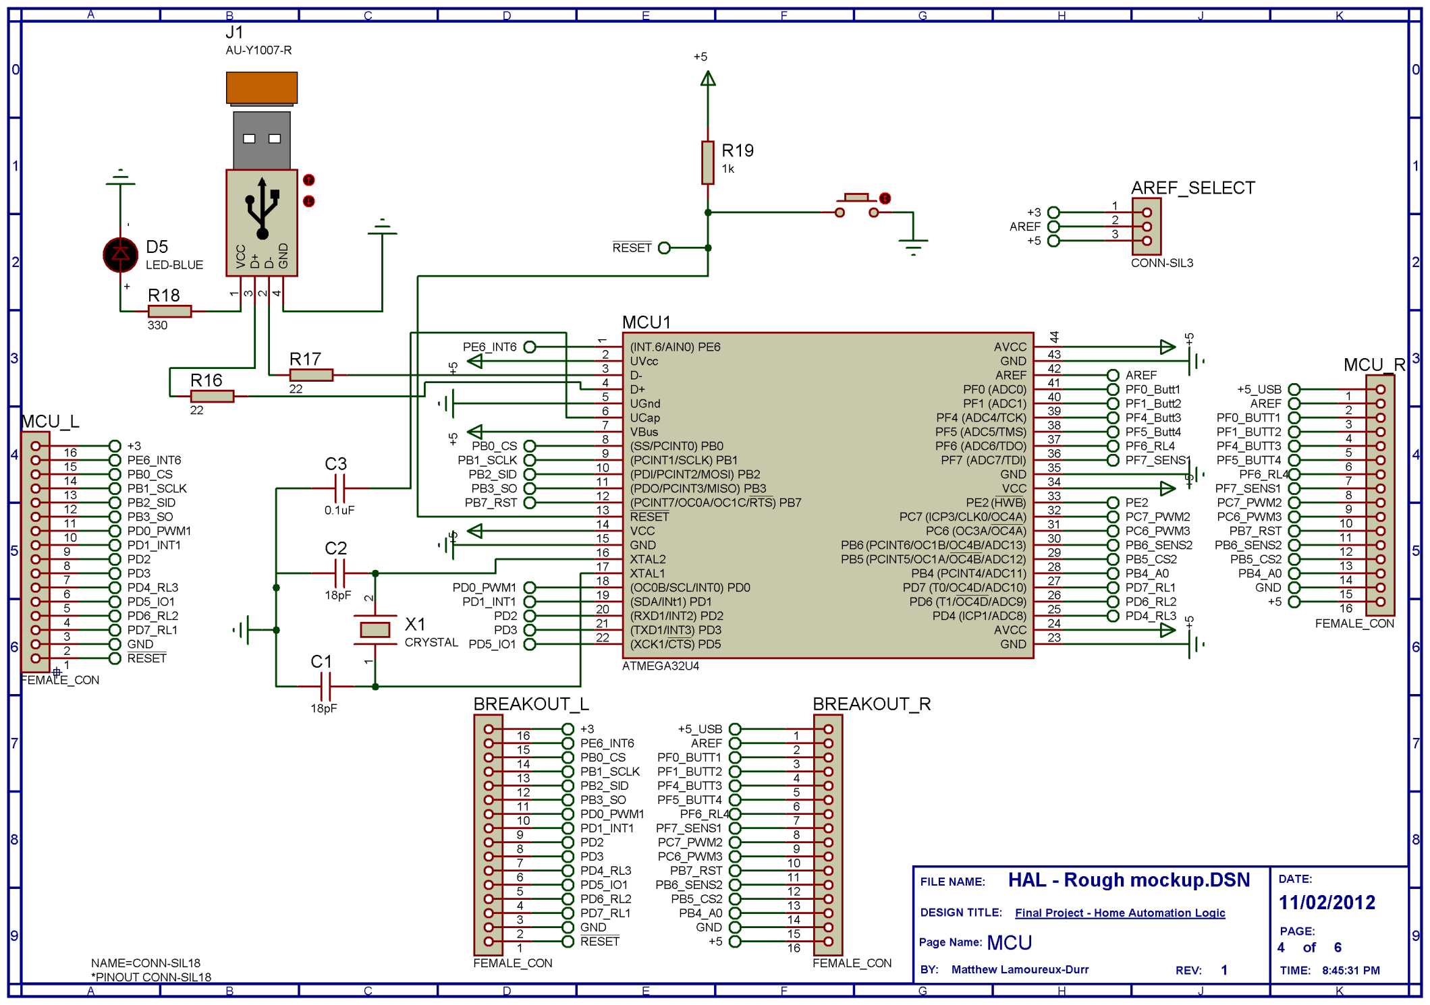

Slide 6
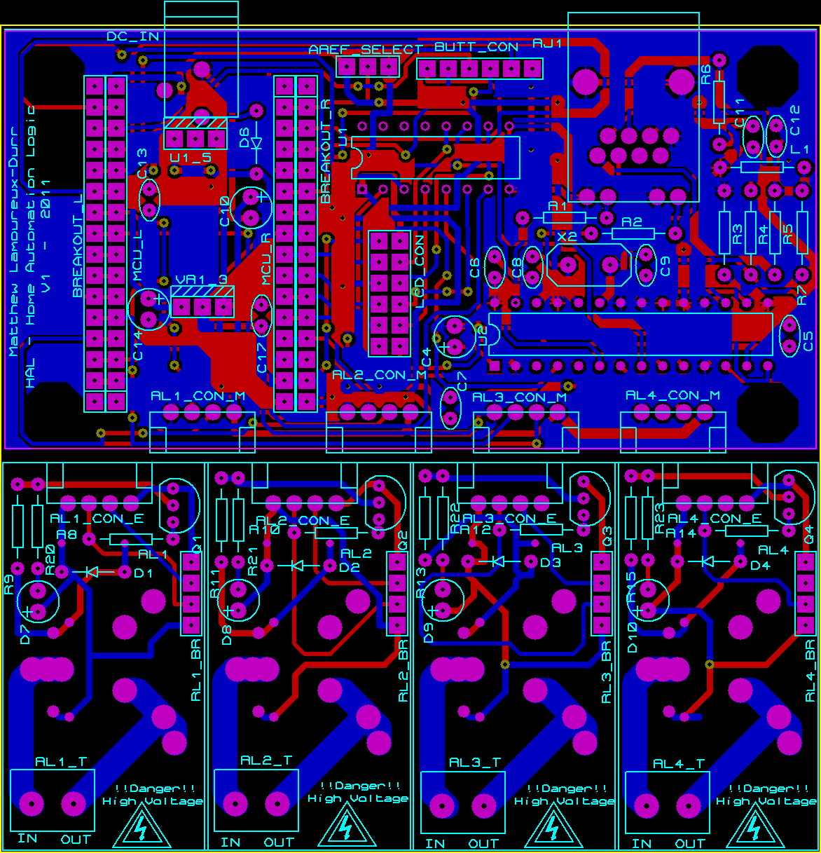

Slide 7
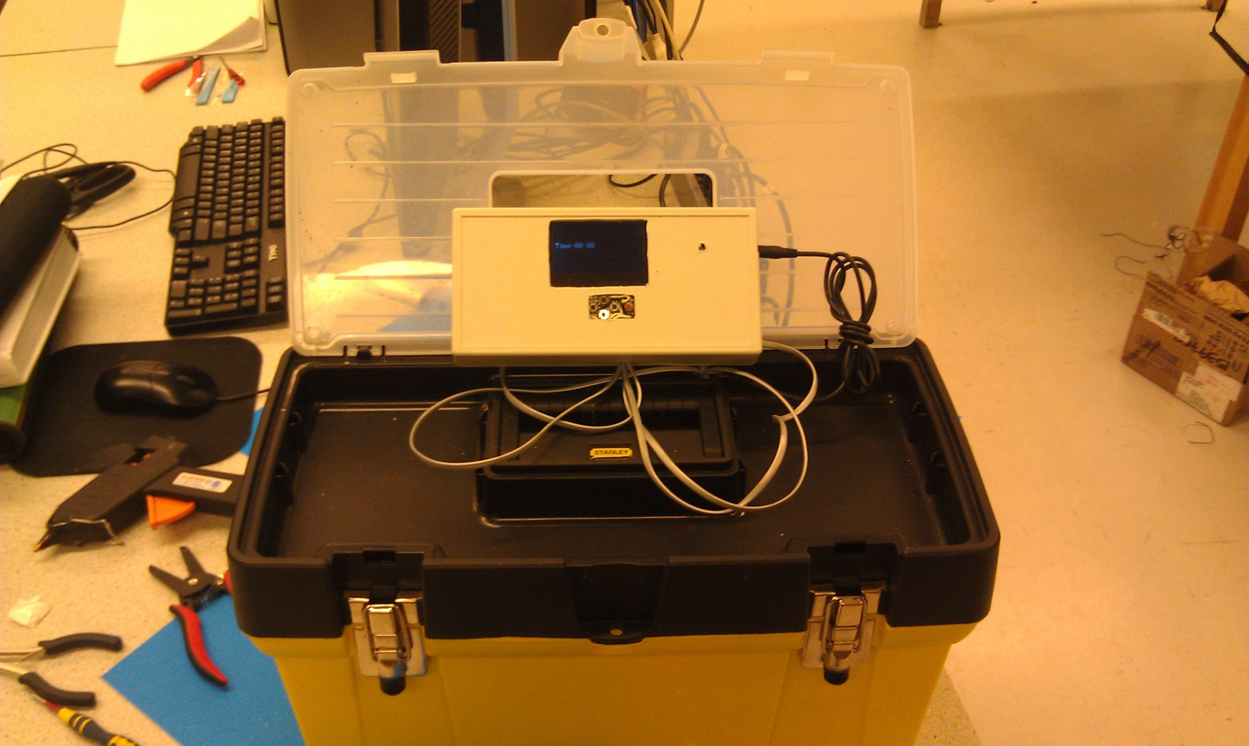
Hardware

Slide 8
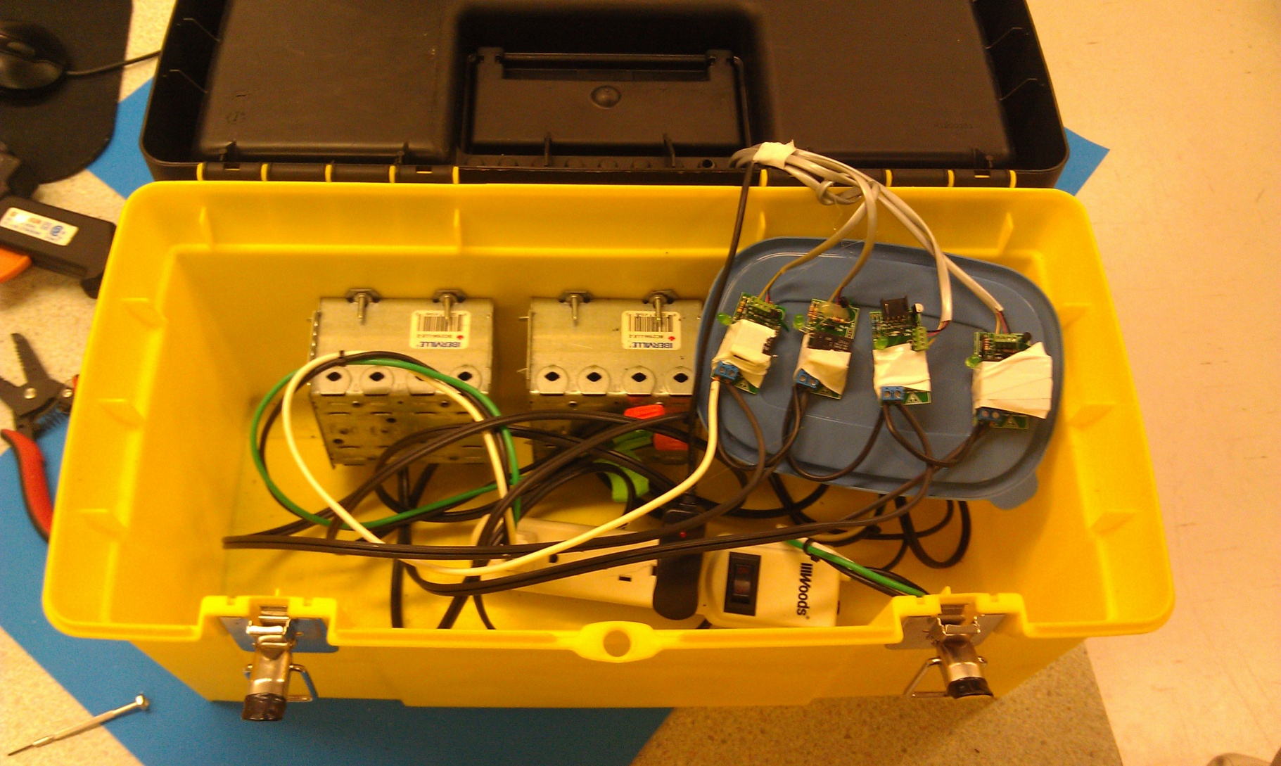
Hardware

Slide 9
Code-Firmware
Libraries used:
Teensy – USB_Serial
Tuxgraphics – Enj28j60, timeconversion
Adafruit - ST7565 Grafical LCD
Major Code Developed:
String command parse
LCD Menu system/display
4 timers for : 3 PWM LEDs, 1 time timer (1ms)
EEPROM structures
Webpages
PROGMEM implementation for functions with strings

Slide 10
Code – GUI
Connects via COM port
Manage Relays
Load/Write Schedule
Set/Load IP address
Send custom serial commands
Hides to taskbar

Slide 11
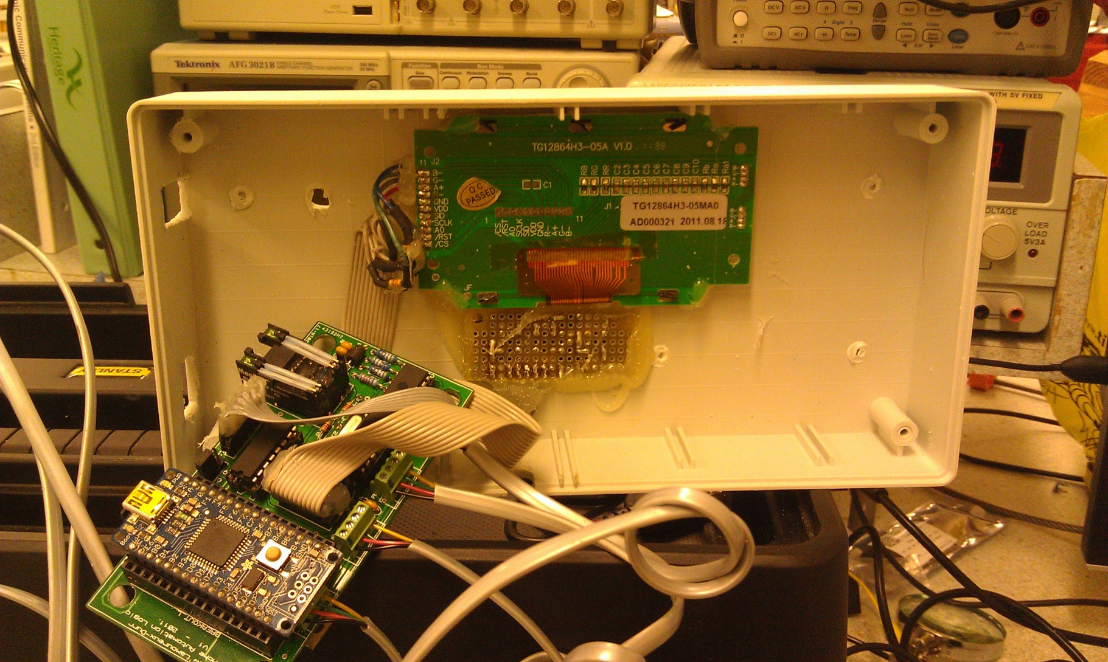

Slide 12
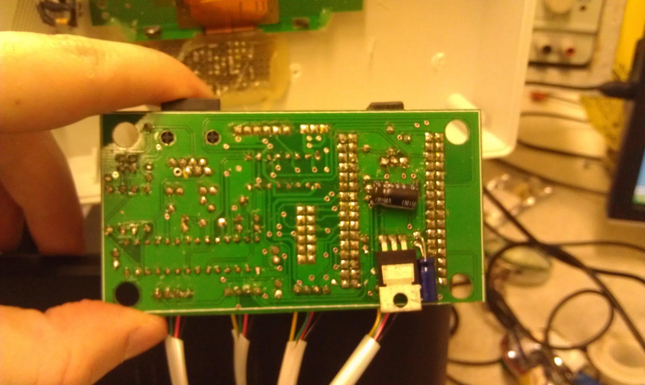

Slide 13
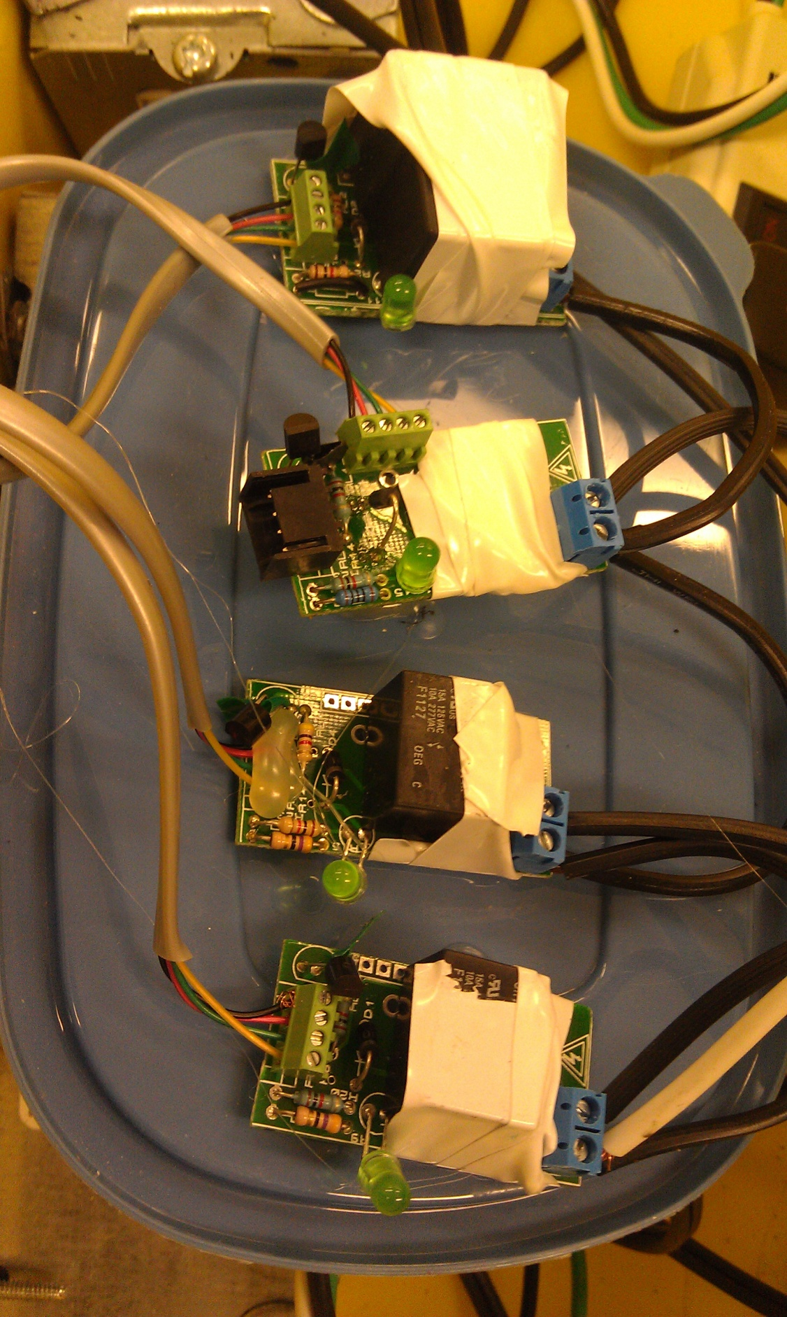

Slide 14
Code Comrimise
Firmware:
Schedule currently not running correctly (does not run events)
LCD Menu system, limited (ran out of time)
Web pages very basic (lost too much time solving bugs)
GUI:
Serialport crashes (windows bug)
Available functions limited
Serialport bugs, make loading schedule crash

Slide 15
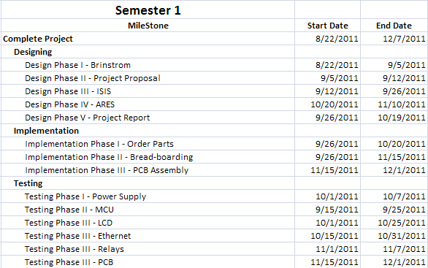
Timeline – Semester 1

Slide 16
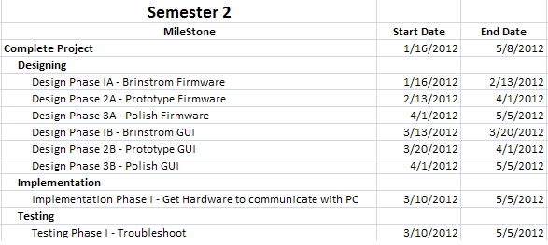
Timeline – Semester 2

Slide 17
Cost
Board:
PCB - $25/10 ($2.5 each)
Micro - $20
Ethernet - $25
Components - $15
LCD - $20
Other:
Relays - $8 (4 total, 3 types)
Enclosure - ~$30
Total:
$145

